Slide 1
5G WIRELESS COMMUNICATION (UEC 719)
Dr. Amit Mishra
Associate Professor,
TIET, Patiala
Dr. Surbhi Sharma
Associate Professor,
TIET, Patiala

Slide 2
Lecture: 4-5
5G NR Frequency Band and Range

Slide 3
Contents
Frequency Band Supported in 5G
Frequency Band Specified by 3GPP
Channel Bandwidth Supported in 5G NR
Types of Channel in 5G NR
5G Channel Hierarchy
5G NR Downlink Physical channel
5G NR Uplink Physical channel
5G NR Transport Channel
5G NR Logical Channel

Slide 4
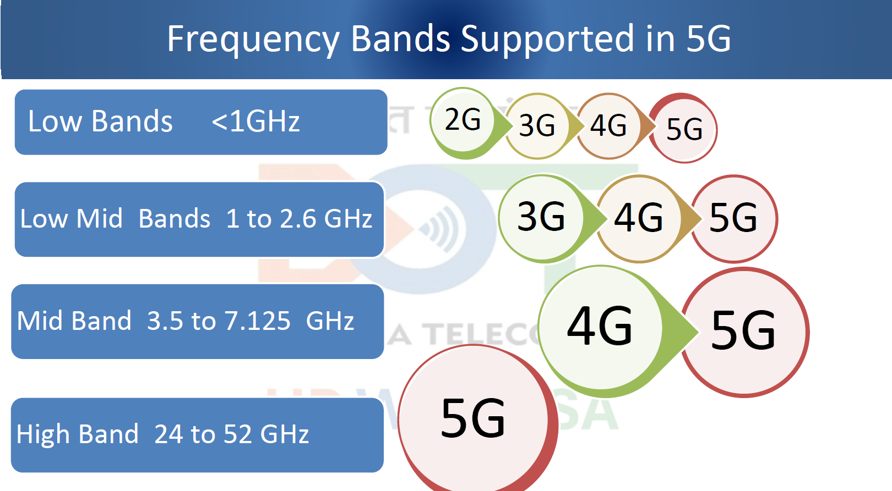

Slide 5
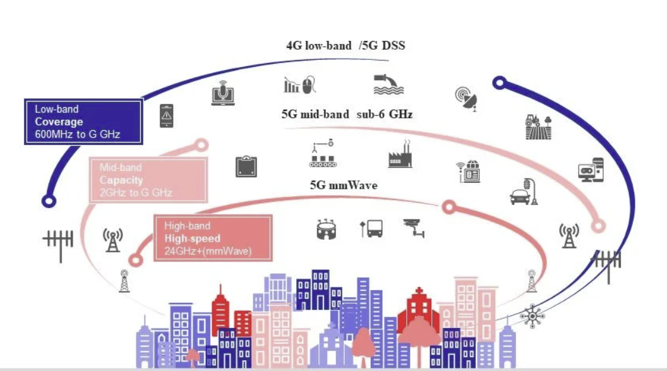

Slide 6
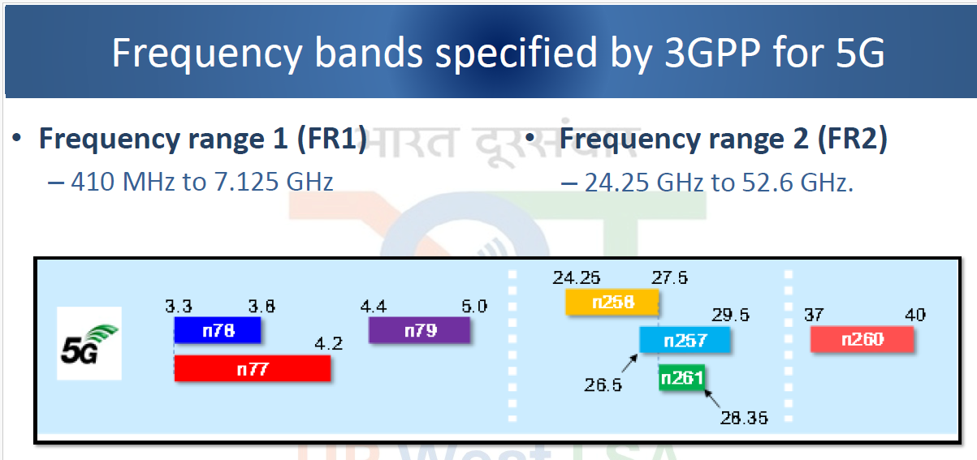

Slide 7
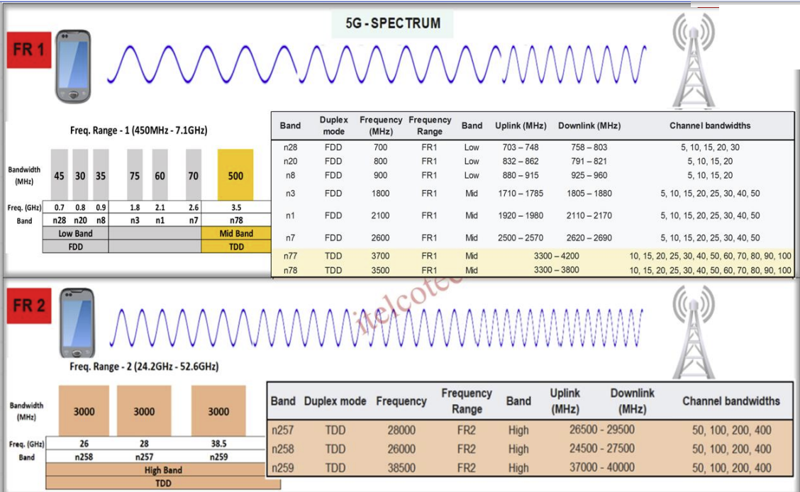

Slide 8
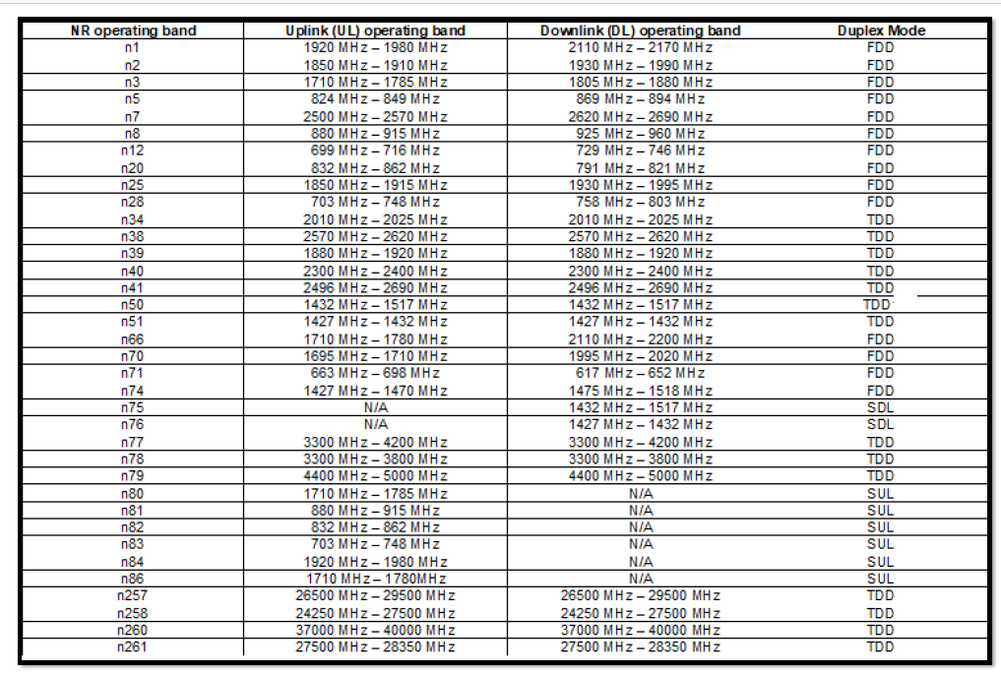

Slide 9
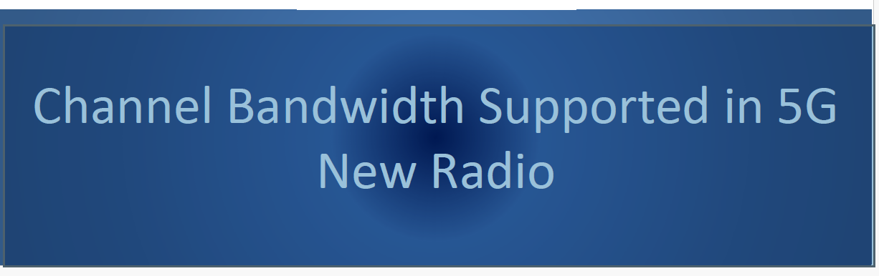

Slide 10
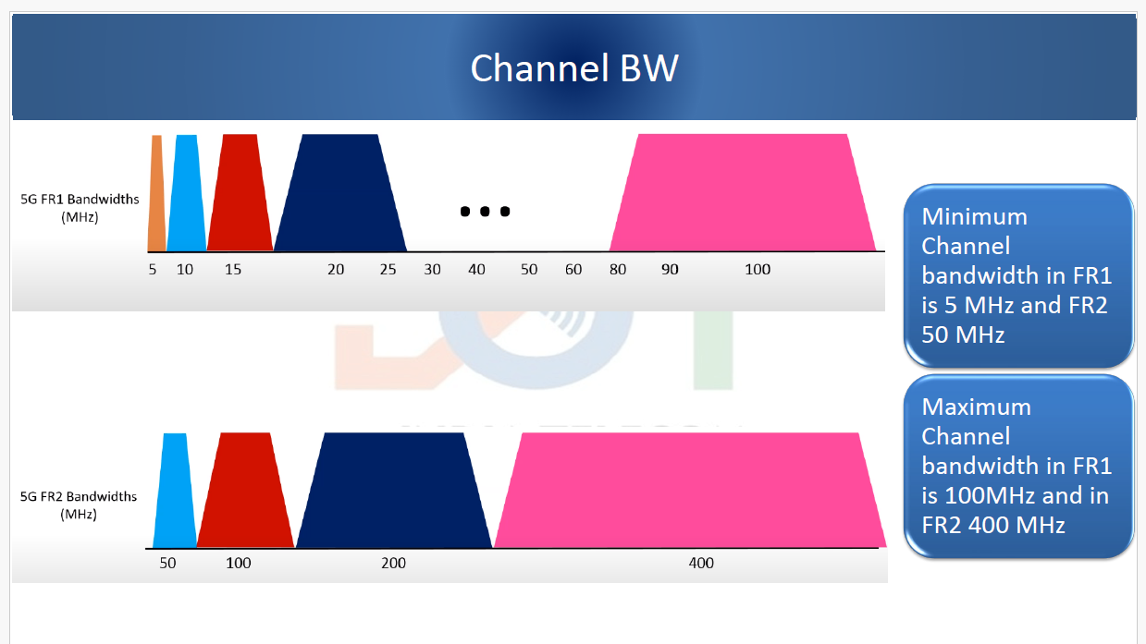

Slide 11
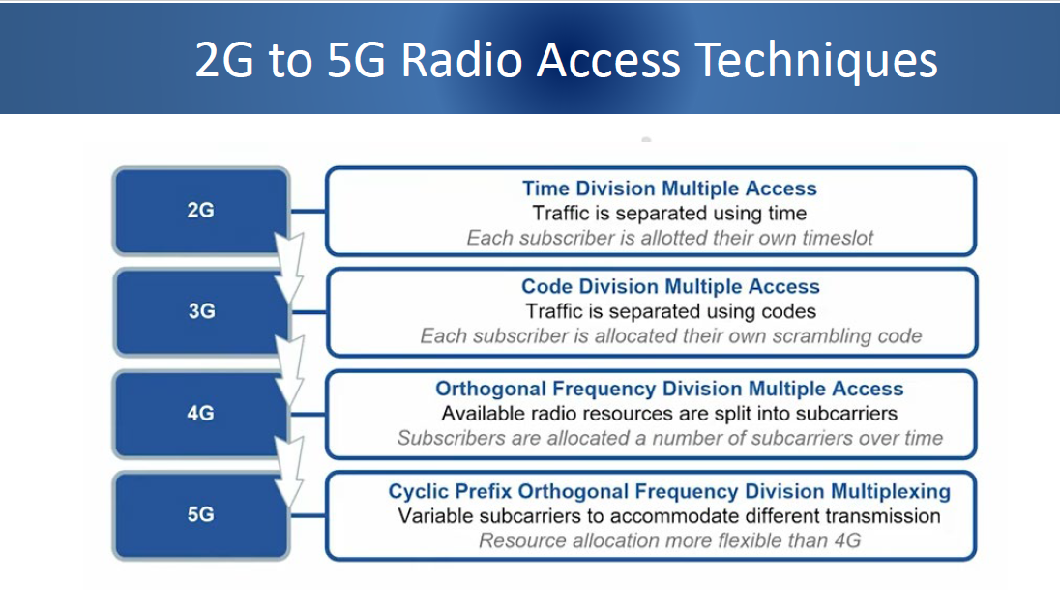

Slide 12
Types of Channel in 5G
There are three main types of data channels that are used within mobile communications systems. This is true for 5G systems, and accordingly the hierarchy is given below.
Logical channel: Logical channels can be one of two groups: control channels and traffic channels
Control channels: The control channels are used for the transfer of data from the control plane
Traffic channels: The traffic logical channels are used for the transfer of user plane data.
Transport channel: Is the multiplexing of the logical data to be transported by the physical layer and its channels over the radio interface.
Physical channel :
The physical channels are those which are closest to the actual transmission of the data over the radio access network / 5G RF signal. They are used to carry the data over the radio interface. The physical channels often have higher level channels mapped onto them of provide a specific service. Additionally, the physical channels carry payload data or details of specific data transmission characteristics like modulation, reference signal multiplexing, transmit power, RF resources, etc.

Slide 13
5G channel hierarchy
There are three main types of data channels that are used within mobile communications systems. This is true for 5G systems, and accordingly the hierarchy is given below.
Logical channel: Logical channels can be one of two groups: control channels and traffic channels
Control channels: The control channels are used for the transfer of data from the control plane
Traffic channels: The traffic logical channels are used for the transfer of user plane data.
Transport channel:
Is the multiplexing of the logical data to be transported by the physical layer and its channels over the radio interface.
Physical channel :
The physical channels are those which are closest to the actual transmission of the data over the radio access network / 5G RF signal. They are used to carry the data over the radio interface. The physical channels often have higher level channels mapped onto them of provide a specific service. Additionally, the physical channels carry payload data or details of specific data transmission characteristics like modulation, reference signal multiplexing, transmit power, RF resources, etc.

Slide 14
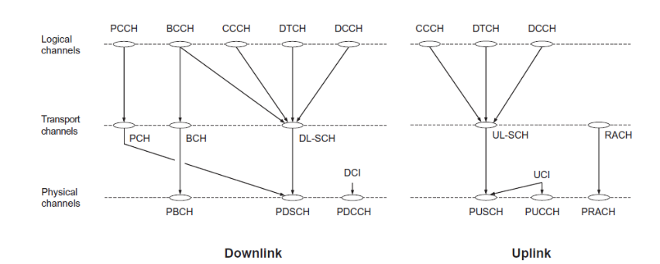
5G channel hierarchy
In total, there are six Physical Channels.
Two channels carry most of the control information (like PDCCH, PUCCH). PBCH is responsible for tasks like UE-synchronization and broadcasting.
PRACH ensures channel access. Actual information payloads (like text messages, audio/video call-data, web-stream etc.) are carried over shared channels (PDSCH and PUSCH).

Slide 15
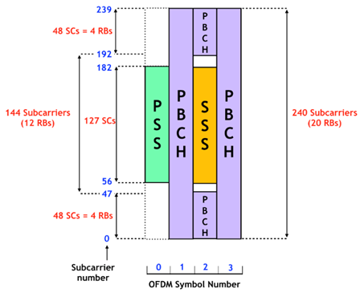
1. 5G NR Downlink Physical Channels
1. Physical Broadcast Channel (PBCH):
The main task for PBCH is to broadcast the Master Information Block (MIB) from gNB to ALL UEs.
PBCH is transmitted with fixed QPSK modulation with 80 ms periodicity, with multiple repetitive transmissions within this period. MIB is most essential for UE to start decoding PDCCH, which in turn helps UE to decode PDSCH. As soon as a UE turns on, it looks for MIB.
PBCH is almost always accompanied by the Synchronization Signals (SSS and PSS) for UE-and-gNB time-frequency synchronization.
Together PBCH/SS is called SSB block (After decoding SSB Block, a UE can read the information in the SIB1 block which contain information for Initial Bandwidth Part for initial access). SSB is always 4 OFDM symbols in time and 20 RBs in the frequency domain.

Slide 16
5G NR Downlink Physical Channels
2. Physical downlink shared channel, PDSCH:
The 5G NR physical downlink shared channel, PDSCH carries data sharing the capacity on a time and frequency basis. The PDSCH physical channel carries a variety of items of data: user data; UE-specific higher layer control messages mapped down from higher channels; system information blocks (SIBs); & paging. The PDSCH uses an adaptive modulation format dependent upon the link conditions, i.e. signal to noise ratio. It also uses a flexible coding scheme. The combination of these means that there is a flexible coding and data rate.
3Physical downlink control channel, PDCCH:
As the name implies, the 5G physical downlink control channel carries downlink control data. Its primary function is scheduling the downlink transmissions on the PDSCH and also the uplink data transmissions on the PUSCH. The PDCCH uses QPSK as its modulation format and polar coding as the coding scheme, except for small packets of data.

Slide 17
5G NR Uplink Physical Channels
1. Physical random access channel, PRACH: This 5G channel - the physical random access channel, PRACH, is used for channel access. It transmits an initial random access pre-amble consisting of sequences which may be of two different lengths:
A long sequence is 839 which is applied to the subcarrier spacings of 1.25kHz and 5 kHz
Short sequence lengths of 139 are applied to subcarrier spacings of 15 kHz and 30 kHz (FR1 bands) and 60 kHz and 120 kHz (FR2 bands).
2. Physical uplink shared channel, PUSCH: The 5G physical uplink shared channel, PUSCH, is the counterpart of the PDSCH. It is used to carry data from the UL-SCH and its higher mapped channels on a frequency and time-shared basis. Like the PDSCH, The PUSCH also has a very flexible format. The allocation of frequency resources is undertaken using resource blocks along with a flexible modulation and coding scheme dependent upon the link signal to noise ratio. To support the channel link estimation and demodulation, the PUSCH contains DMRS signals

Slide 18
5G NR Uplink Physical Channels
3. Physical uplink control channel, PUCCH:
The 5G physical uplink control channel, PUCCH, carries the uplink control data. It is also possible that dependent upon the resource allocation the uplink control information or data may also be sent on the PUSCH, even though in the downlink direction, control information is always sent on the PDCCH

Slide 19
2. 5G NR Transport Channels
There are five different transport channels. Some are used on the uplink, others on the downlink, and some can be used on both.
Broadcast Channel, BCH: The BCH 5G channel is used in the downlink only for transmitting the BCCH system information and specifically the Master Information Block, MIB, information. In order that the data can be utilised, it has a specific format.
Paging Channel, PCH: The PCH is used for carrying paging information from the PCCH logical channel. The PCH supports discontinuous reception, DRX, to enable the UE to save battery power by waking up at a specific time to receive the PCH. In order that the PCH is received by all mobiles / UEs in the cell, the PCH must be broadcast over the entire cell as a single message, or where beam forming is used, this can be done using several different PCH instances.
Downlink Shared Channel, DL-SCH: As the name indicates, this is a downlink-only channel. It is the main transport channel used for transmitting downlink data and it supports all the key 5G NR features. These include: dynamic rate adaptation; HARQ, channel aware scheduling, and spatial multiplexing. The DL-SCH is also used to transmit information about some parts of the BCCH system, specifically the SIB. Each UE has a DL-SCH for each cell it is connected to.

Slide 20
2. 5G NR Transport Channels
Uplink Shared Channel, UL-SCH: This is the uplink counterpart to the DLSCH that is, the uplink transport channel used for transmission of uplink data.
Random-Access Channel, RACH: The RACH is a transport channel, which carries the random access preamble which is used to overcome the message collisions that can occur when UEs access the system simultaneously.

Slide 21
3. 5G NR Logical Channels
There are several different logical channels that are used within the 5G NR radio access network. Some of thee will be familiar names from the 4G LTE system as the names have been carried over.
Broadcast Control Channel, BCCH: The BCCH is used within the downlink, and it is used for sending broadcast-style information to the user equipment within that cell. The system information transmitted by the 5G NR BCCH is divided into different blocks:
Master Information Block, MIB: There is one MIB and this is mapped onto the BCH transport channel and then to the PBCH physical channel.
System Information Block, SIB: There are several system information blocks, SIBs. These are mapped onto the DL-SCH transport channel and then onto the PDSCH physical channel.

Slide 22
3. 5G NR Logical Channels
Paging Control Channel, PCCH: This is a Downlink channel. It is used to page the UEs whose location at cell level is not known to the network. As a result the paging message needs to be transmitted in multiple cells. The PCCH is mapped to the PCH transport channel and then to the PDSCH physical channel.
Common Control Channel, CCCH: : This 5G channel is used on both the downlink and uplink for transmitting control information to and from the user equipments or mobiles. The channel is used for initial access, i.e. those mobiles that do not have a radio resource control, RRC connection.
Dedicated Control Channel, DCCH: The DCCH is used within the uplink and downlink to carry dedicated control information between the UE or mobile and the network. It is used by the UE and the network after a radio resource control, RRC connection has been established.
Dedicated Traffic Channel, DTCH: This 5G channel is present in both the uplink and downlink. It is dedicated to one UE and is used for carrying user information to and from a specific UE and the network.

Slide 23
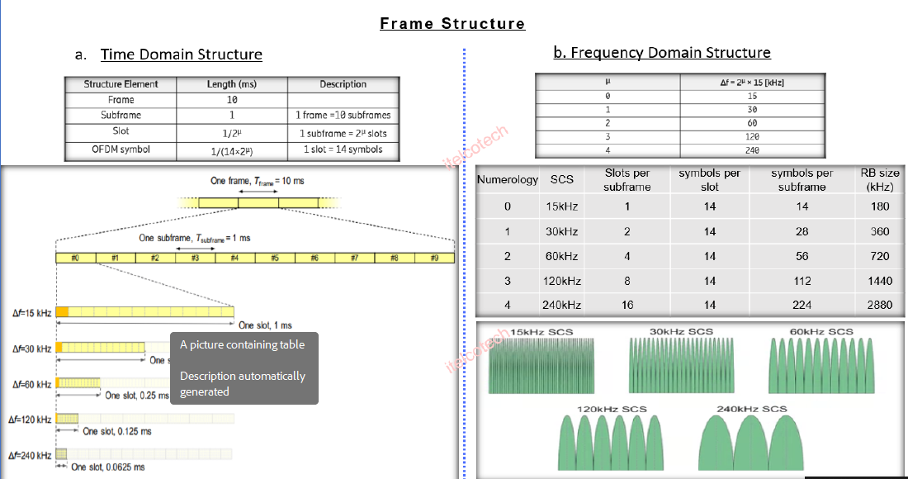
5G NR Frame Structure

Slide 24
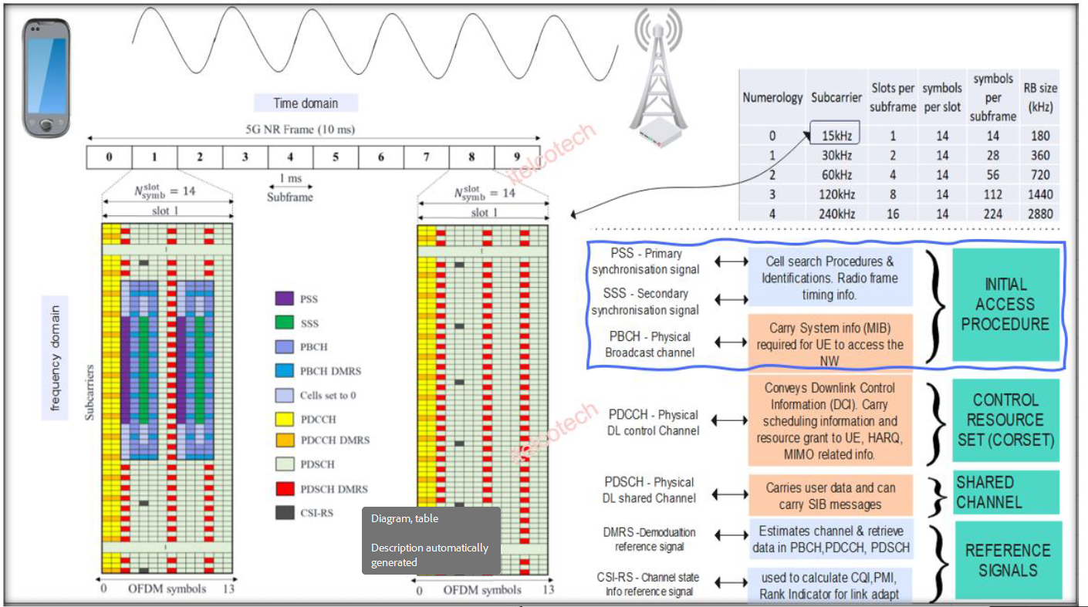
5G NR Frame and DL channels

Slide 25
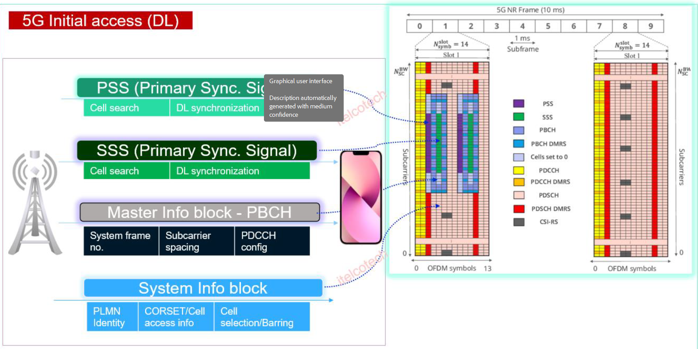
5G NR Initial DL channels

Slide 26
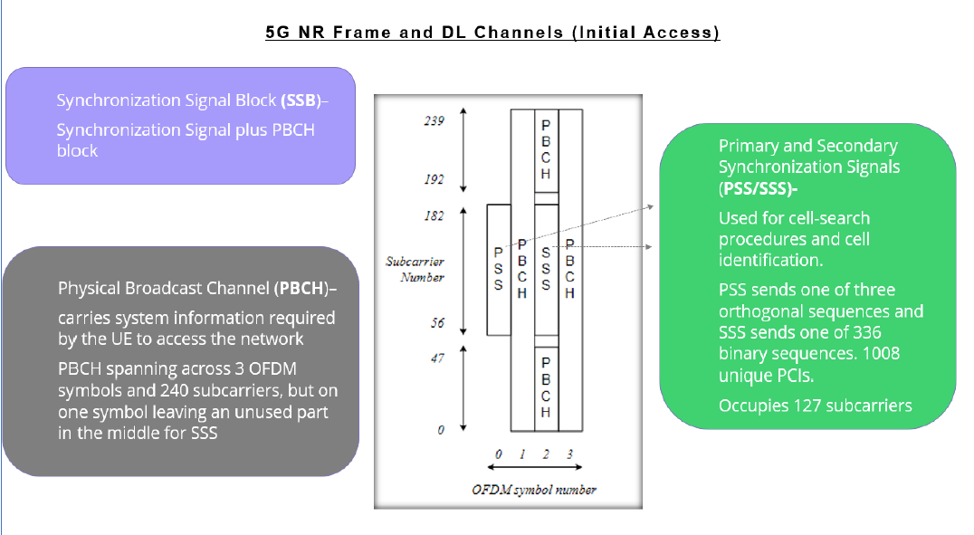
5G NR Frame and DL channels

